Slide 1

Capstone Project
Lending Club
Savvy Invest, LLC
By: Nickolas Abrarpour

Slide 2
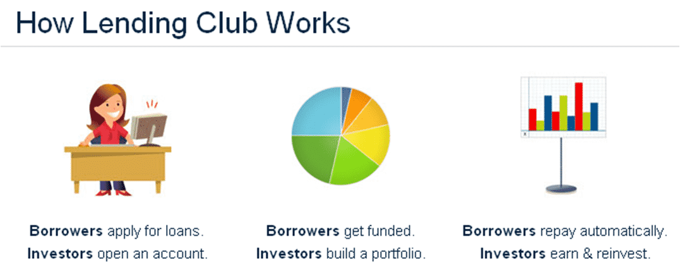
Lending Club
Borrowers
Apply for loans
Receive funding
Investors
Reduce intermediary cost
Diversify loan portfolio
Higher rates of return

Slide 3
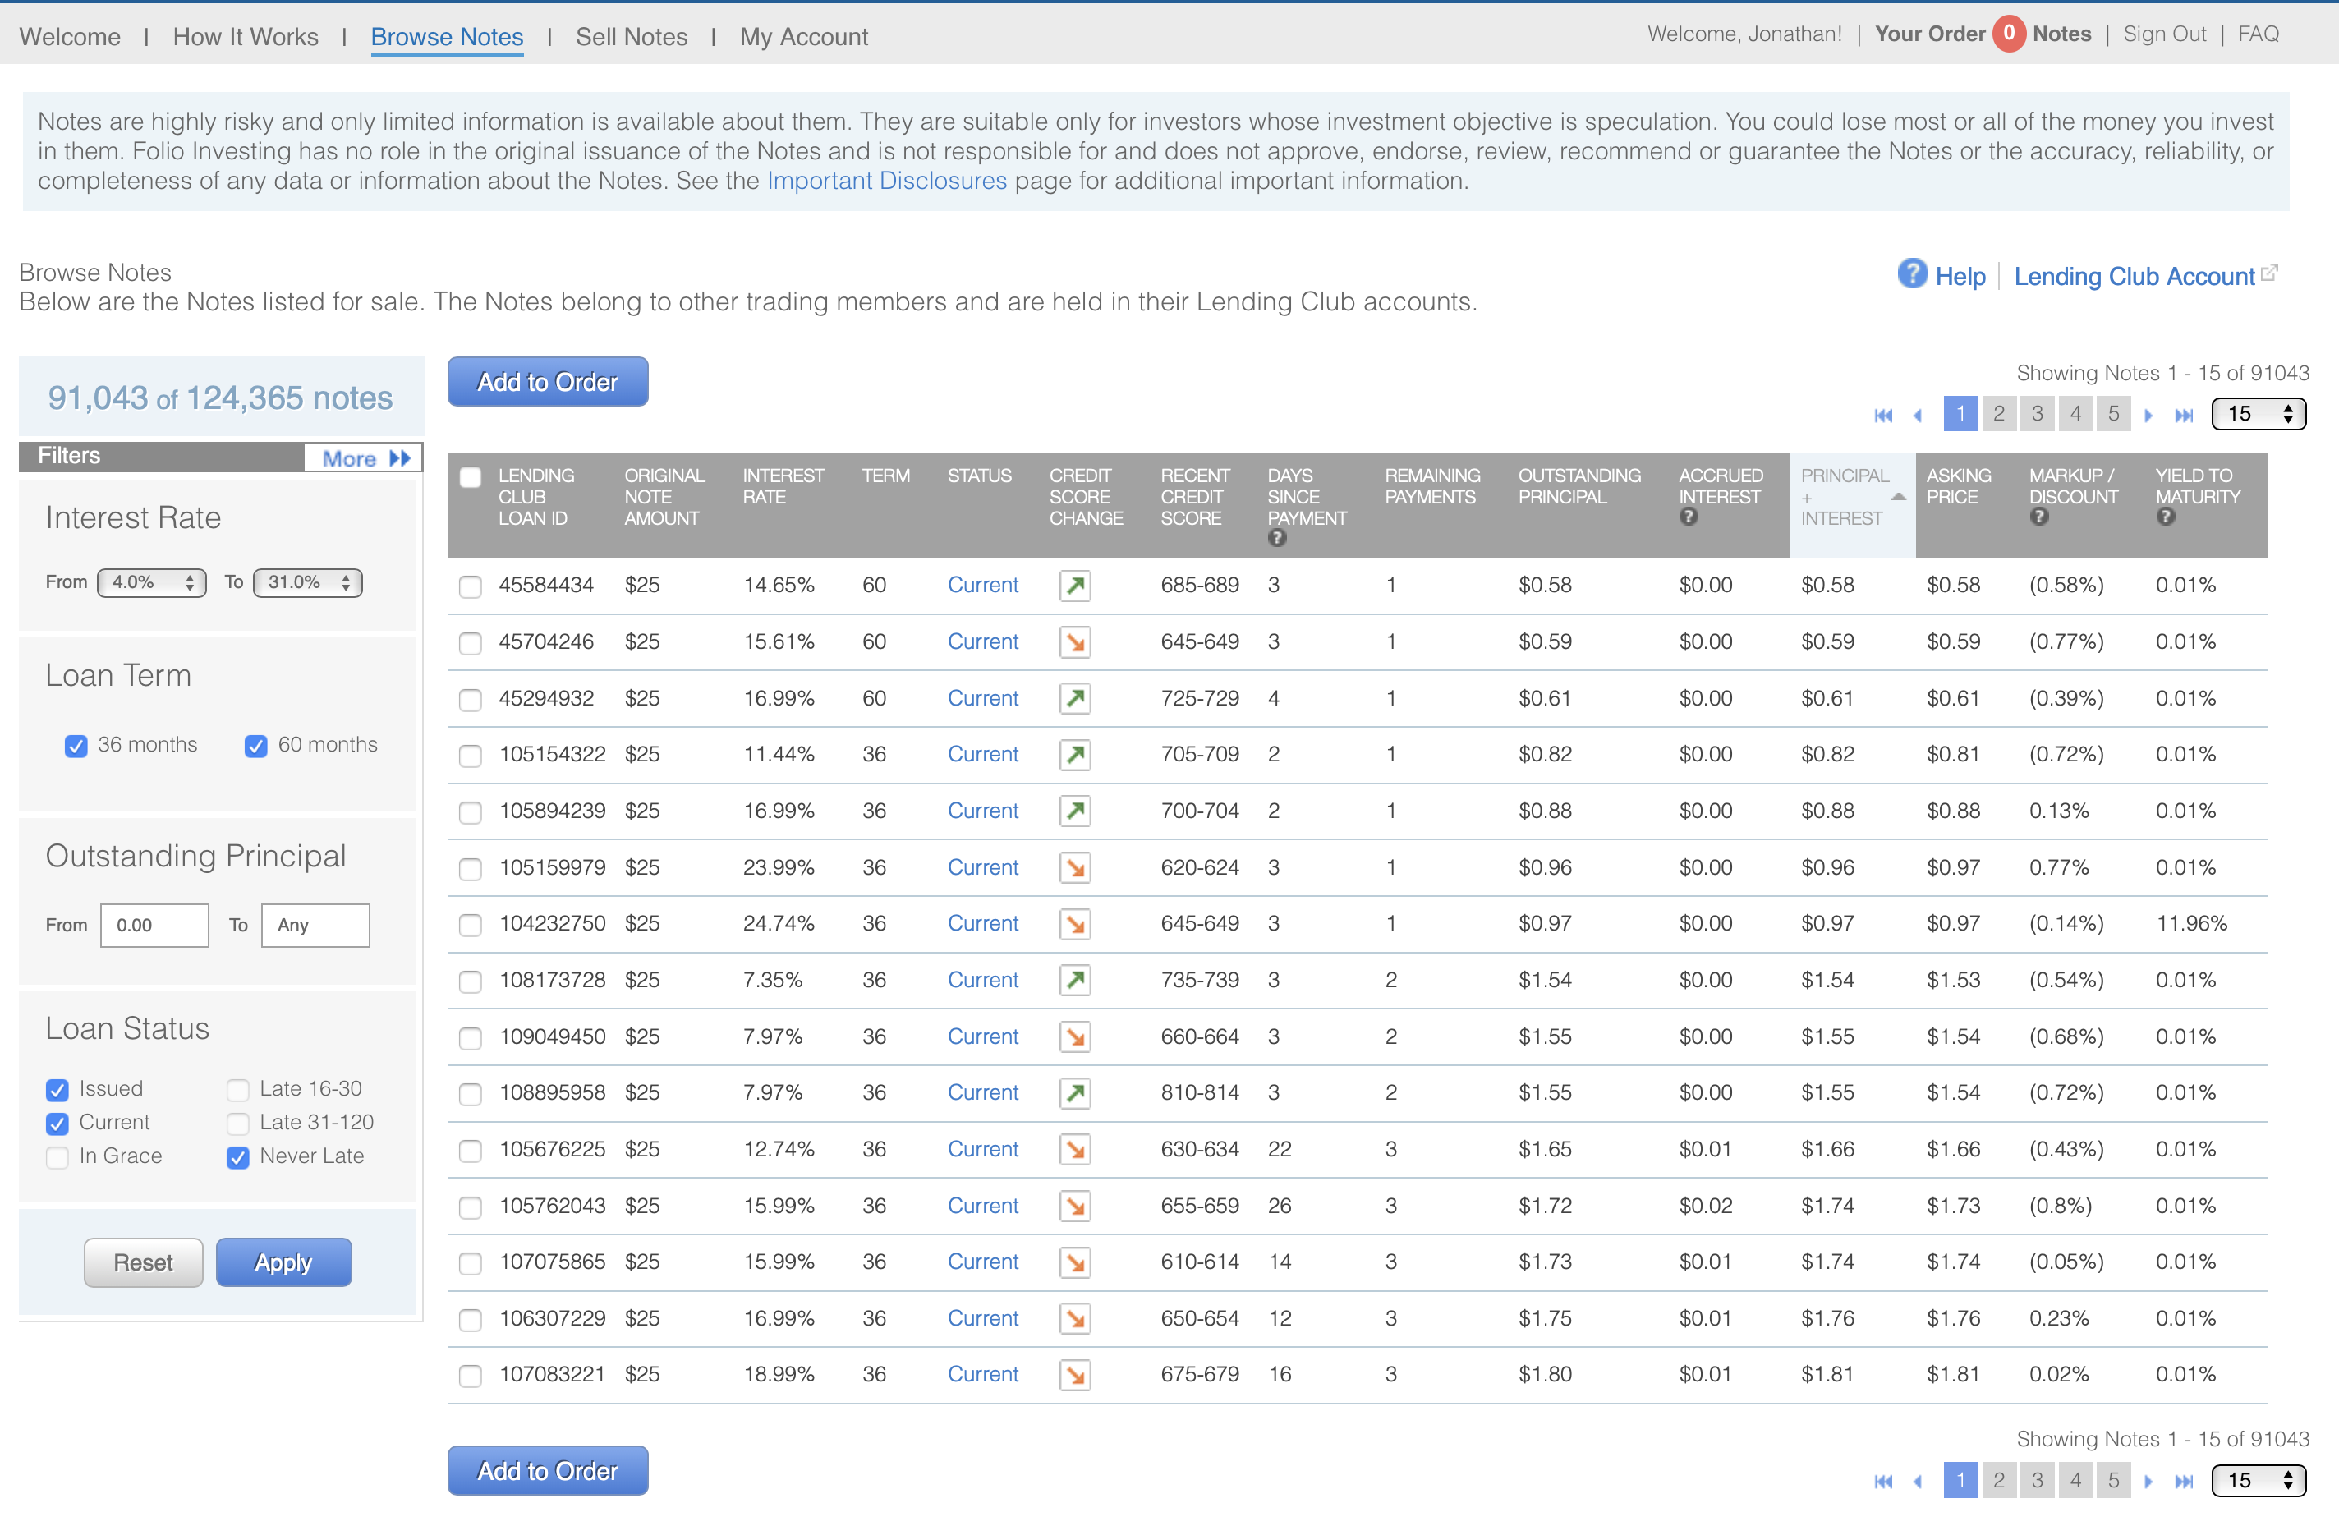
WWW.LENDINGCLUB.COM

Slide 4

SAVVY INVEST LLC
MISSION
SPECIFIC GOALS
ADVANTAGES
Generate valuable insights and machine learning models in order to improve the investment process for P2P lenders
Accurately predict the probability of loan defaults
Create insightful visualizations between important features and target variable
Machine learning
Financial Expertise
Built in Beautiful.ai
4

Slide 5
Agenda
1
2
Who We are
Who We're TARGETING
Brief History
Objective
Value-Added Credit Analysis
Machine Learning Tasks
Investors
Competitors
3
What We're Planning
Future Endeavors
Future Work
2

Slide 6


Our Founding Philosophy
To adapt personal and professional spaces to the increasingly diverse and interconnected world between humans and data.
Built in Beautiful.ai
3

Slide 7
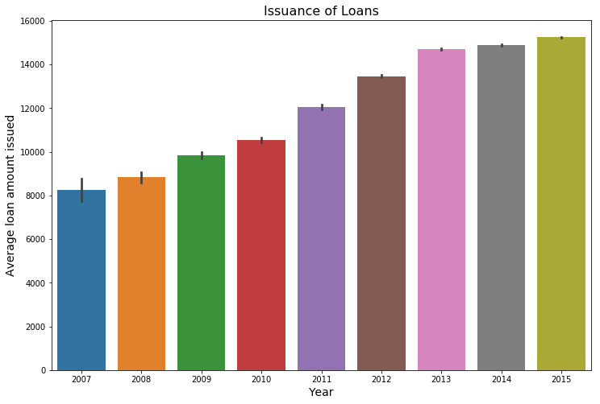
Issuance of Loans by Year
Built in Beautiful.ai
9

Slide 8
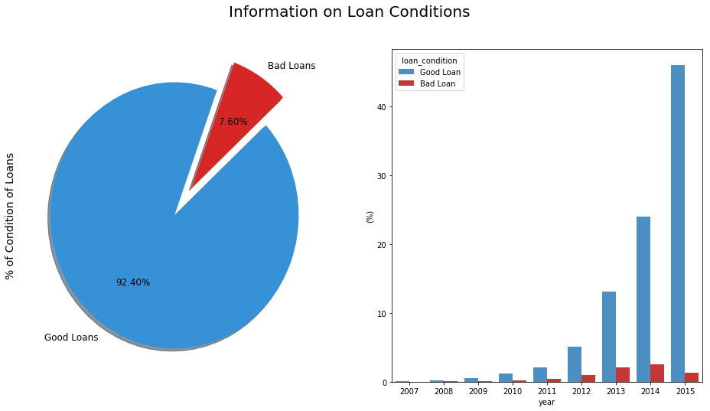
Loan Conditions
Built in Beautiful.ai
9

Slide 9
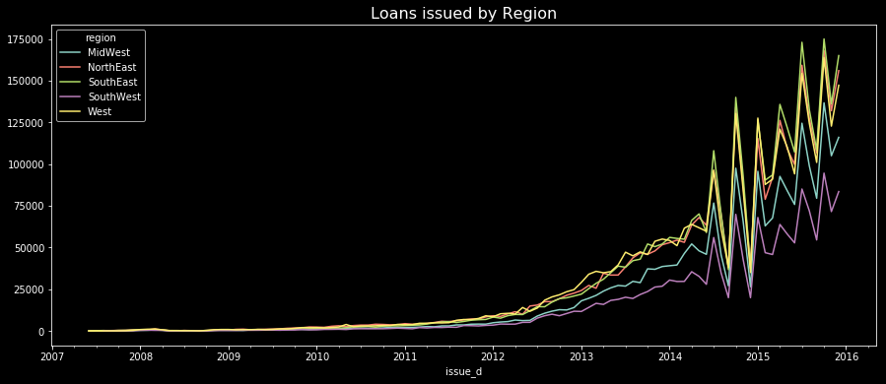
Loans Issued by Region
Important regional patterns to consider?
Southeast , West and Northeast regions had the highest amount of loans issued.
West and Southwest had a rapid increase in debt-to-income starting in 2012.
West and Southwest had a rapid decrease in interest rates (possibly explains increase in debt to income)
Built in Beautiful.ai
9

Slide 10
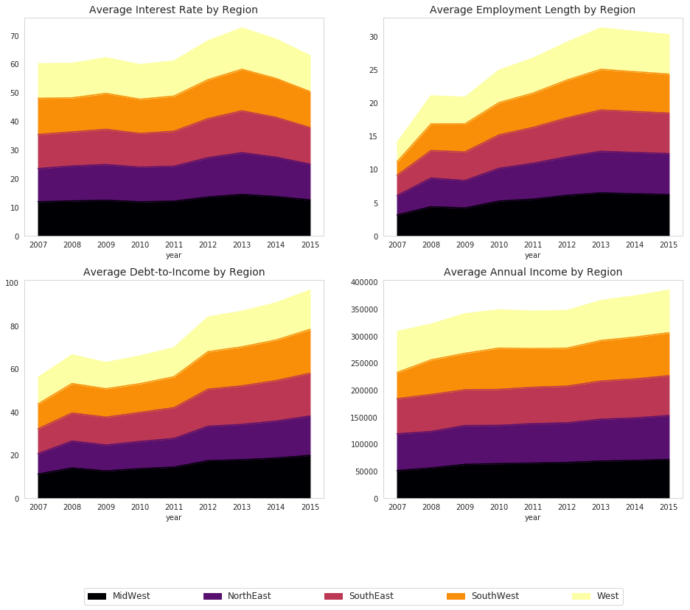
Loans Issued by Region (cont’d)
West and SouthEast had a higher percentage in most of Grade B "bad" loans
The NorthEast region had a higher percentage in Grace Period and Does not meet Credit Policy loan status. (both are not considered as bad as default for instance)
West and SouthEast regions have the most undesirable loan status, but just by a slightly higher percentage compared to the NorthEast region.
Regional analysis gives us an idea of geographic distribution (and not the risk level of loans)
Built in Beautiful.ai
9

Slide 11
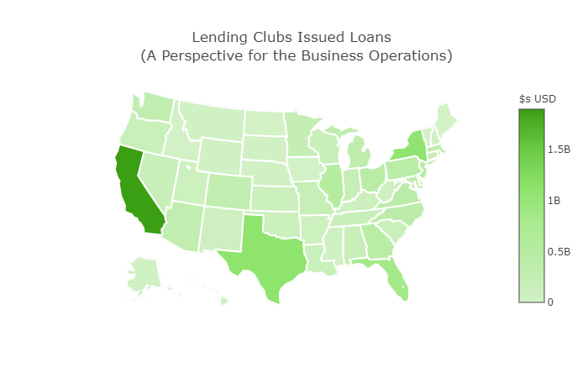
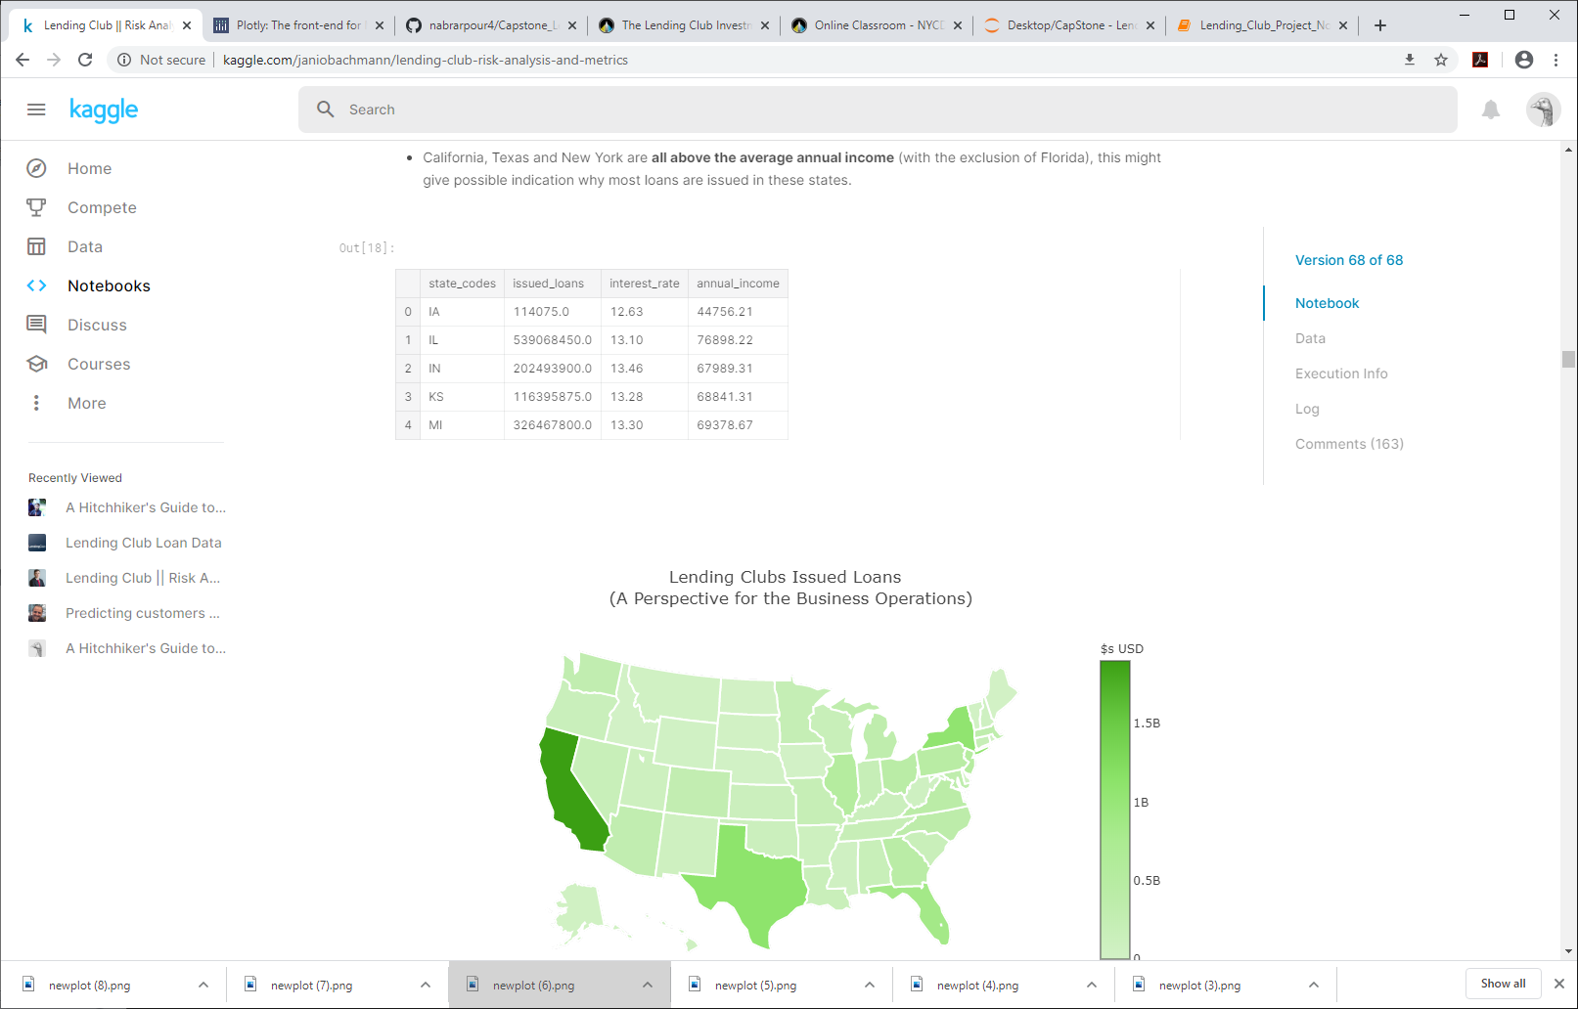
Loans Issued by State
Summary:
- California, Texas, New York and Florida are the states in which the highest amount of loans were issued.
- Interesting enough, all four states have ~ interest rates of 13% which is at the same level of the average interest rate for all states (13.24%)
- California, Texas and New York are all above the average annual income (with the exclusion of Florida), this might give possible indication why most loans are issued in these states.
Built in Beautiful.ai
9

Slide 12
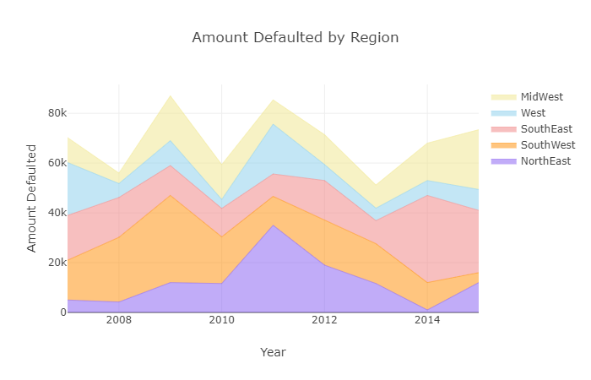
Regional Default
Built in Beautiful.ai
10

Slide 13
Analysis by Income Category
Created different income categories in order to detect important patterns and do an in-depth analysis.
Points to consider:
- Low income category: Borrowers that have an annual income lower or equal to 100,000 usd.
- Medium income category: Borrowers that have an annual income higher than 100,000 usd but lower or equal to 200,000 usd.
- High income category: Borrowers that have an annual income higher tha 200,000 usd.
Summary:
Borrowers that made part of the high income category took higher loan amounts than people from low and medium income categories. Of course, people with higher annual incomes are more likely to pay loans with a higher amount. (First row to the left of the subplots)
Loans that were borrowed by the Low income category had a slightly higher change of becoming a bad loan. (First row to the right of the subplots)
Borrowers with High and Medium annual incomes had a longer employment length than people with lower incomes.(Second row to the left of the subplots)
Borrowers with a lower income had on average higher interest rates while people with a higher annual income had lower interest rates on their loans. (Second row to the right of the subplots)
Built in Beautiful.ai
9

Slide 14
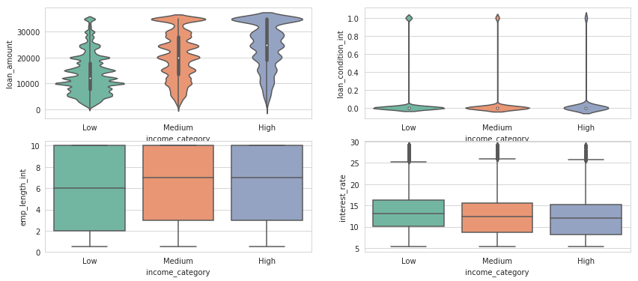
Analysis by Income Category
Built in Beautiful.ai
9

Slide 15
Determination of a Bad Loan
What we need to know:
There might be possible factors that contribute in whether a loan is bad or not.
Factors that increase risk : low annual income, high debt to income, high interest rates, low grade, among others.
Summary:
- The types of bad loans in the last year are having a tendency to decline, except for late payments (might indicate an economical recovery.)
Mortgage was the variable from the home ownership column that used the highest amount borrowed within loans that were considered to be bad.
There is a slight increase on people who have mortgages that are applying for a loan.
- People who have a mortgage (depending on other factors as well within the mortgage) are more likely to ask for
Built in Beautiful.ai
9

Slide 16
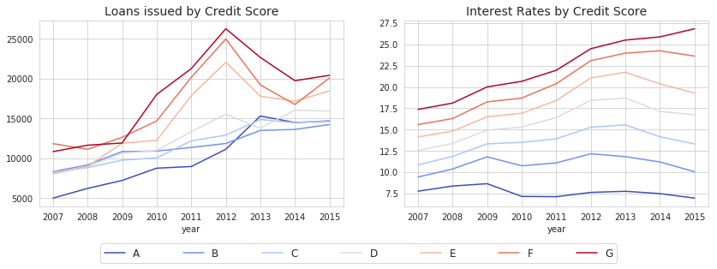
The Importance of Credit Scores vs. Loan Grade
Credit scores are important metrics for the evaluation of overall level of risk. In this section we will analyze the level of risk as a whole and how many loans were bad loans by grade type from customer’s credit score.
What we need to know:
- The lower the grade of the credit score, the higher the risk for investors.
- There are different factors that influence on the level of risk of the loan.
Built in Beautiful.ai
9

Slide 17
The Importance of Credit Scores vs. Loan Grade (cont’d)
Summary:
- Loans with lower grades receive a larger amount of loans (which might contribute to a higher level of risk).
Logically, the lower the grade the higher the interest the customer had to pay back to investors.
Customers with a grade of "C" were more likely to default on the loan
Built in Beautiful.ai
9

Slide 18
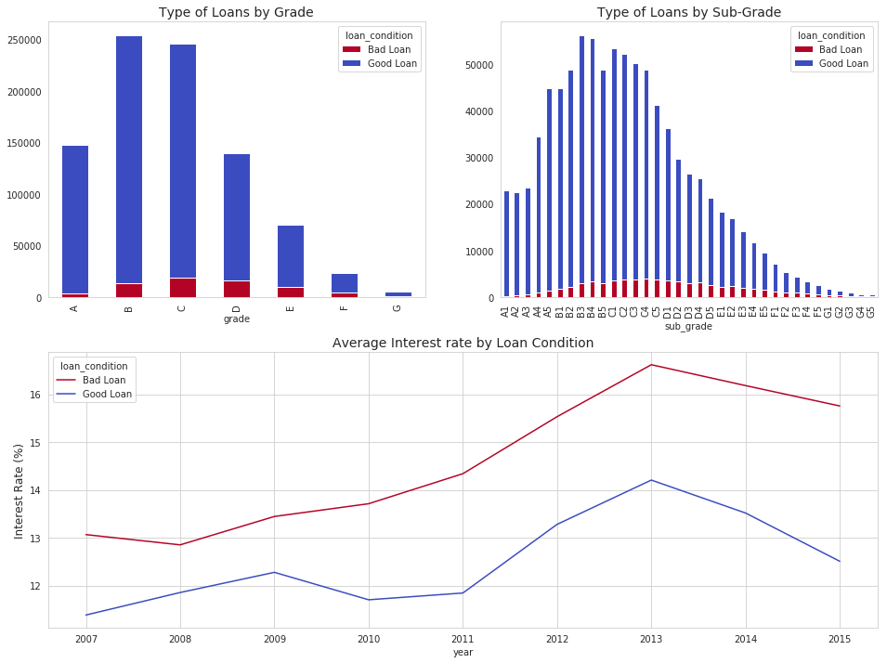
EDA: Credit Scores vs. Loan Grade (cont’d)
Built in Beautiful.ai
9

Slide 19
Good/Bad Loan Summary
- Bad Loans Count: People that apply for educational and small business purposed tend to have a higher risk of being a bad loan. (% wise)
- Most frequent Purpose: The reason that clients applied the most for a loan was to consolidate debt.
- Less frequent purpose: Clients applied less for educational purposes for all three income categories.
- Interest Rates: In all reasons for application except (medical, small business and credi card), the low income category has a higher interest rate. Something that could possibly explain this is the amount of capital that is needed from other income categories that might explain why the low income categories interest rate for these puposes are lower.
- Bad/Good Ratio: Except for educational purposes (we see a spike in high income this is due to the reasons that only two loans were issued and one was a bad loan which caused this ratio to spike to 50%.), but we can see that in all other purposed the bad good ratio is lower the higher your income category.
Built in Beautiful.ai
9

Slide 20
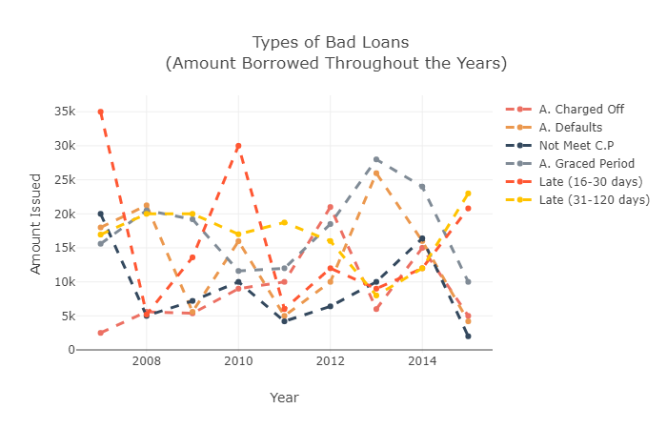
Types of Bad Loans Borrowed by Year
Condition of the loan seems to be important
Built in Beautiful.ai
9

Slide 21
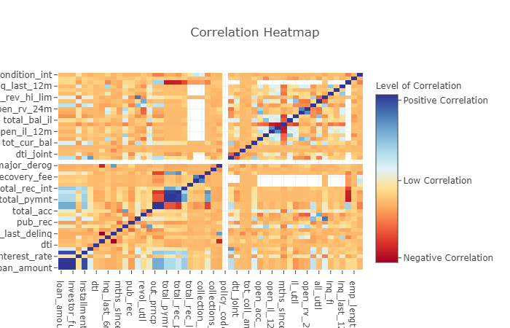
Correlation of Features
Built in Beautiful.ai
7

Slide 22
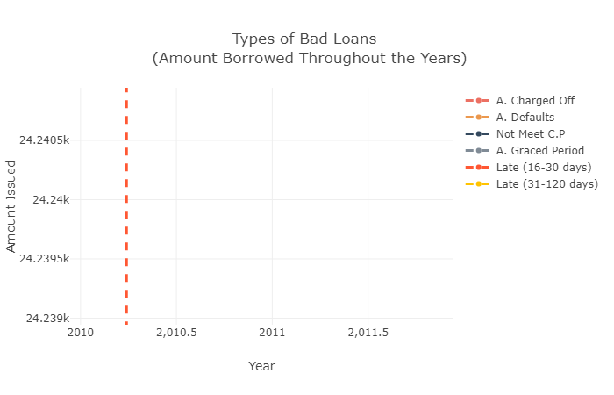
Types of Bad Loans
Built in Beautiful.ai
7

Slide 23
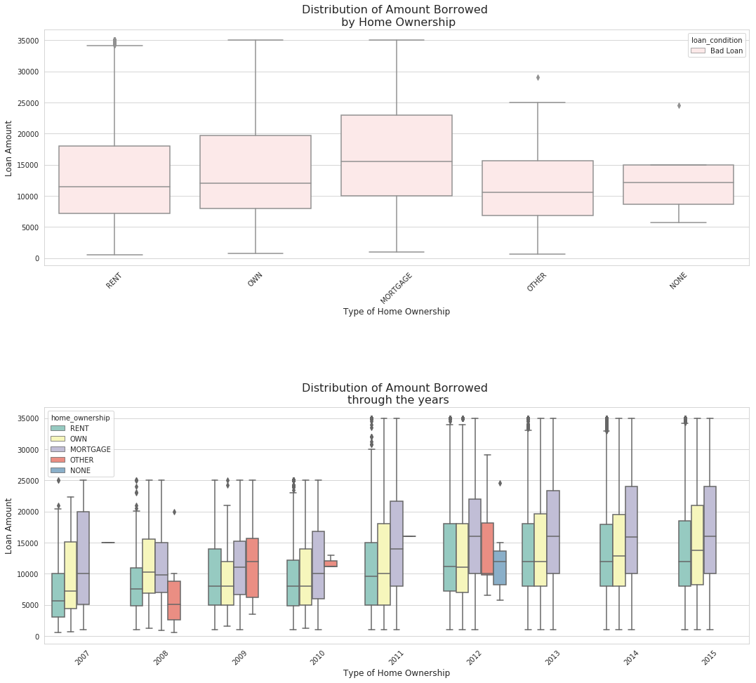
Distribution of Amount Borrowed
Built in Beautiful.ai
7

Slide 24
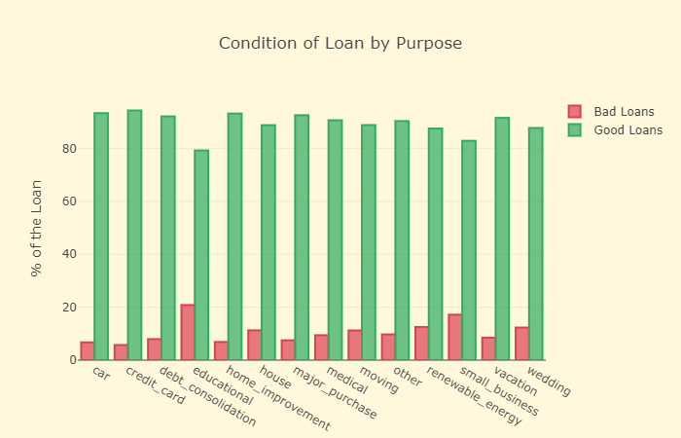
Condition of Loans and Purpose
Built in Beautiful.ai
7

Slide 25
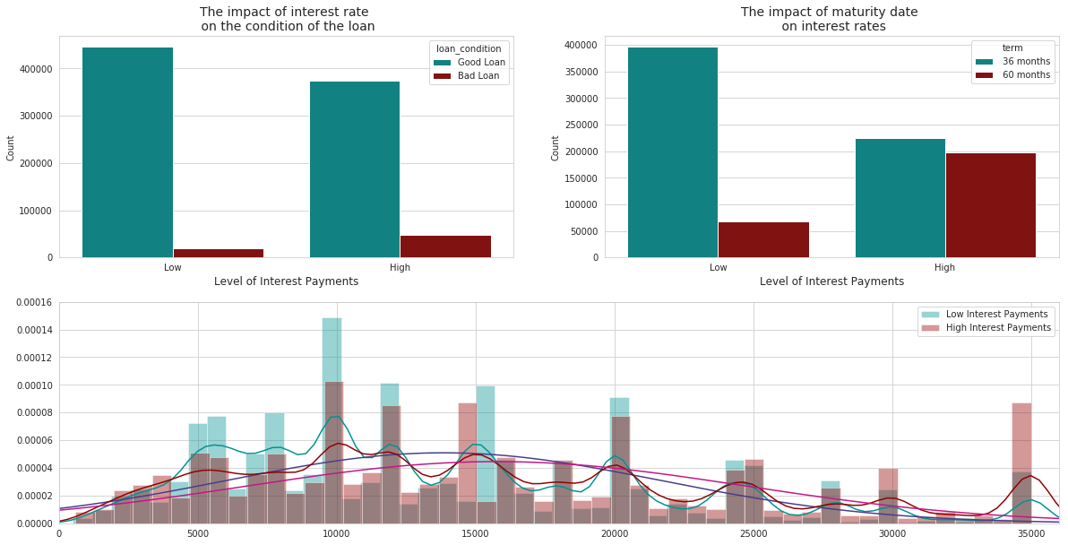
Interest Rate vs. Condition of Loans
Built in Beautiful.ai
7

Slide 26
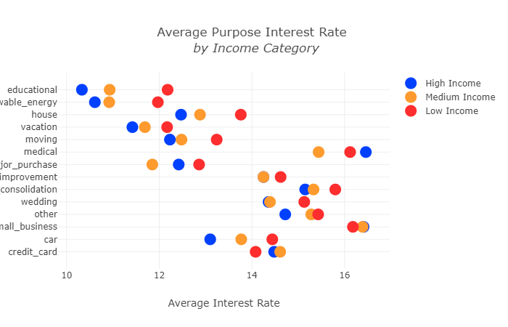
Average Purpose by Interest Rate
Built in Beautiful.ai
10

Slide 27
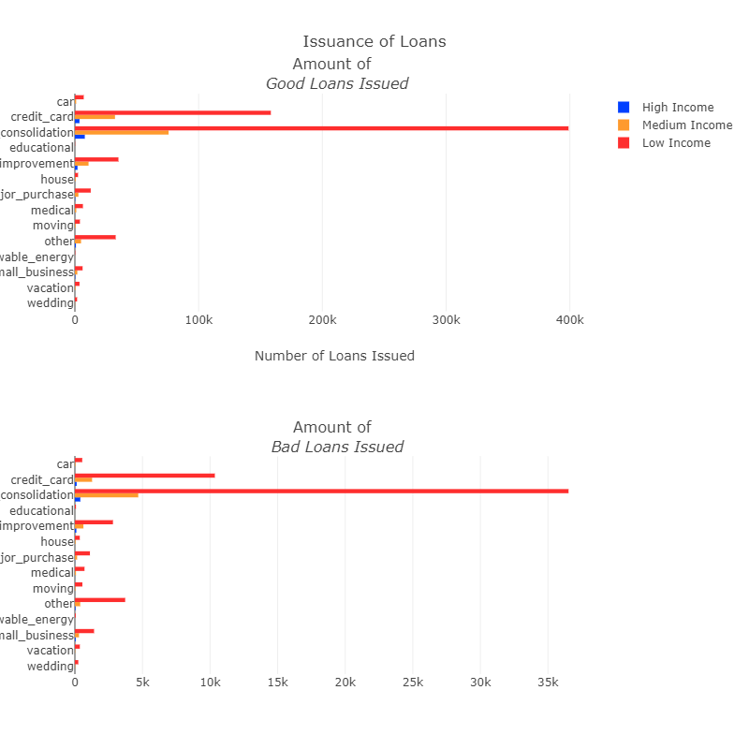
Good/Bad Loans
Built in Beautiful.ai
10

Slide 28
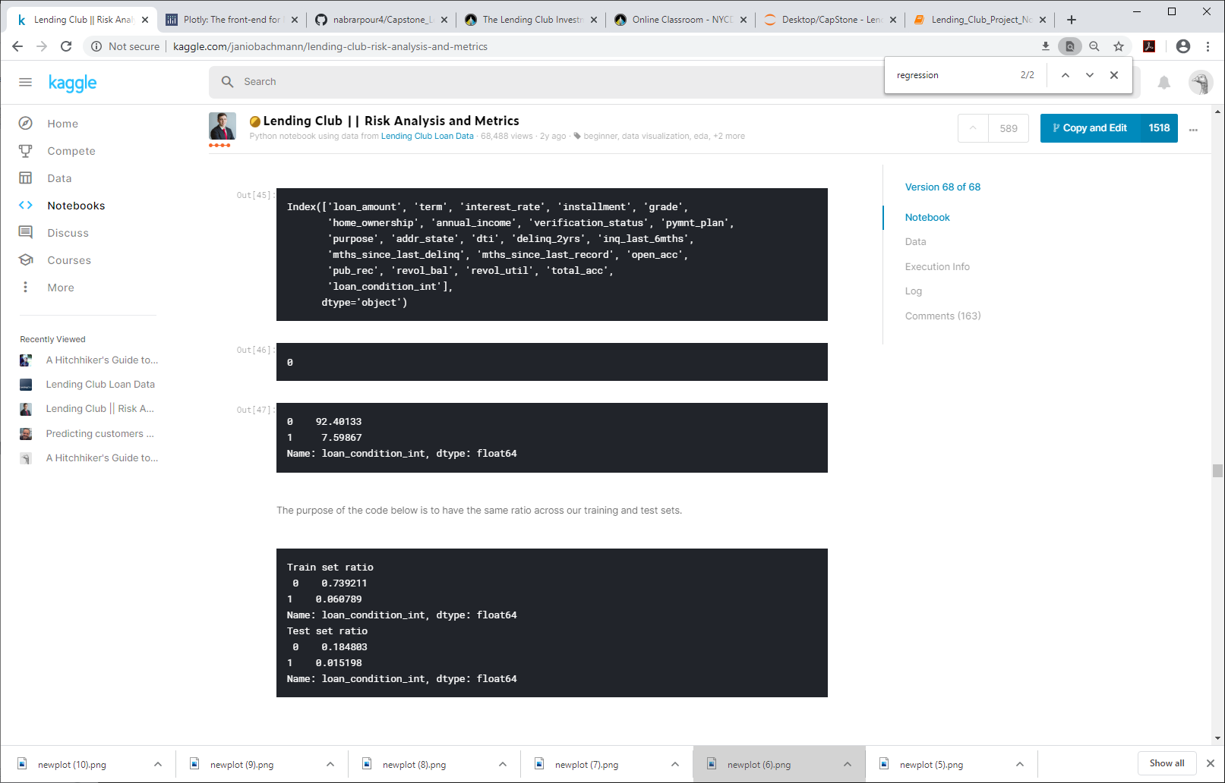
Model Training
Steps:
- There are features that are redundant (as show in the beginning of this kernel in the distribution subplots) having no effect towards the "loan_condition" label so we need to drop these features.
- Use StrattifiedShuffleSplit to have approximately the same ratio of bad loans compared to good loans in both training and testing data. Remember that over 92% of the loans are considered good loans so it is important to have this same ration across training and testing sets.
Built in Beautiful.ai
10

Slide 29
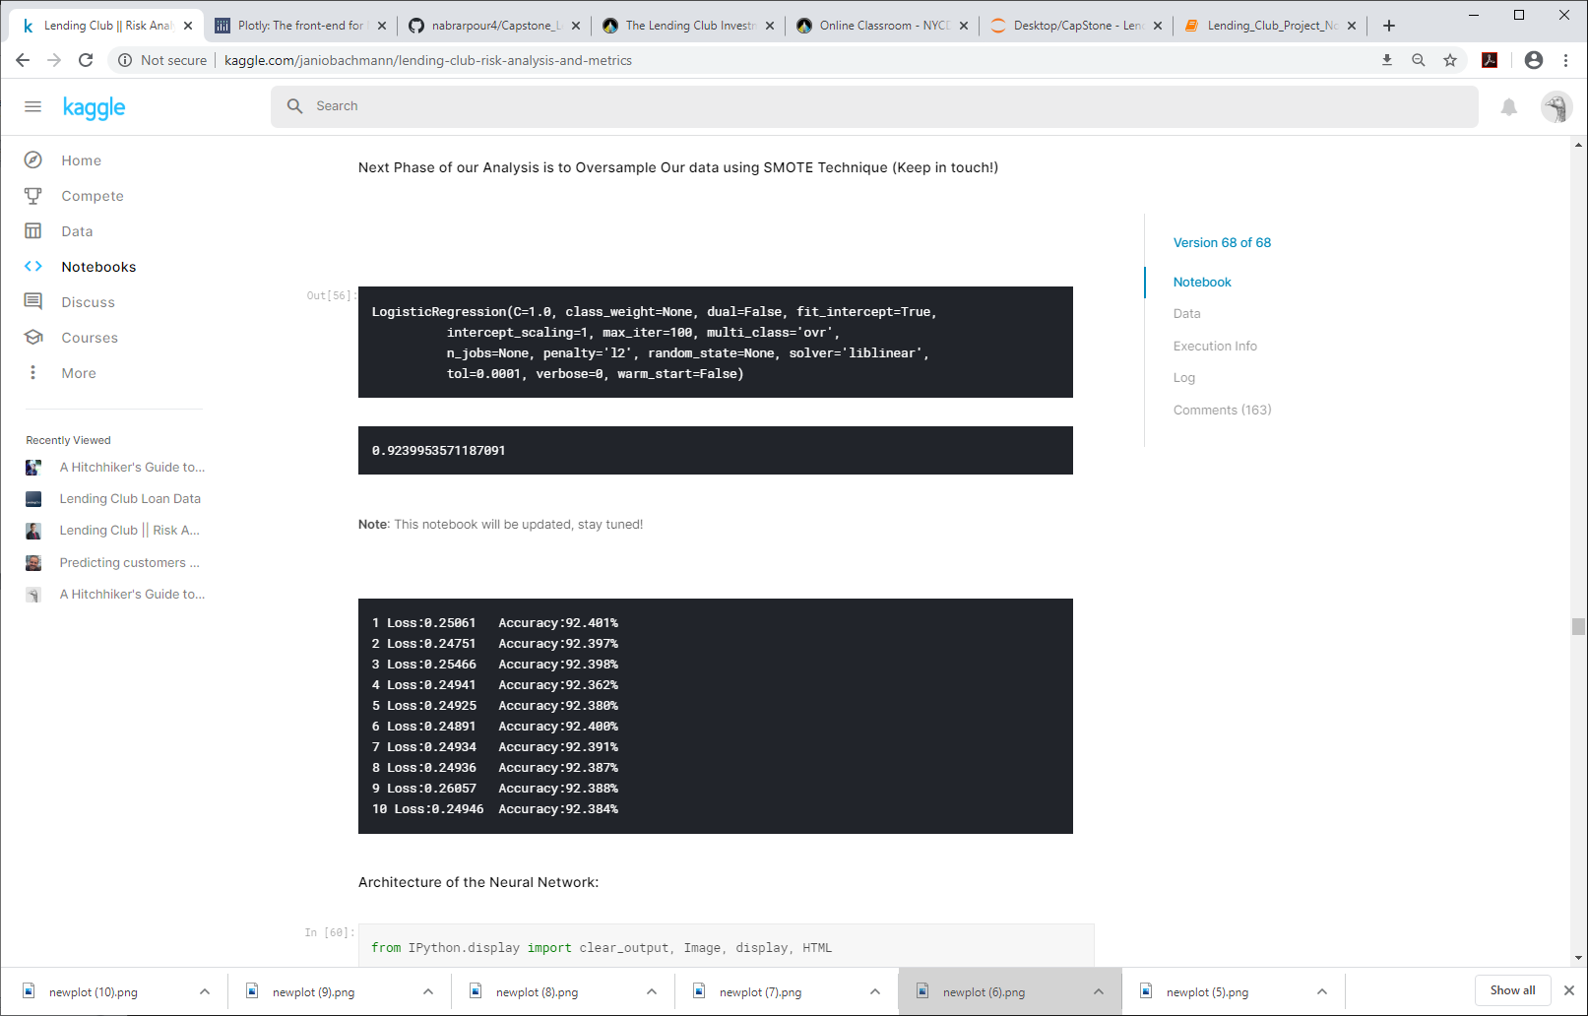
Logistic Regression
Our data is oversampled using the SMOTE technique
Built in Beautiful.ai
10

Slide 30
Feature Engineering & Neural Network
Steps:
There are features that are redundant (as show in the beginning of this kernel in the distribution subplots) having no effect towards the "loan_condition" label so we need to drop these features.
Use StrattifiedShuffleSplit to have approximately the same ratio of bad loans compared to good loans in both training and testing data. Remember that over 92% of the loans are considered good loans so it is important to have this same ration across training and testing sets.
Scale numeric features and encode categorical features from our dataframe.
Run our Neural Network containing the number of inputs, 2 hidden layers (first: 15 nodes, second: 5 nodes) and the number of outputs which is equivalent to 2.
Built in Beautiful.ai
10

Slide 31
Questions?
Built in Beautiful.ai
10

